Slide 1

Development of a Website for the Department of Computer Science &Engineering of Jahangirnagar University.
Submitted By
Supervisor
S. Sadrul Hossain
Id: CSE201702113
Batch: 14th
Program: PMSCS
Department of Computer Science and Engineering,
Jahangirnagar University
Professor Dr. Md. Imdadul Islam
Chairman, Department of Computer Science and Engineering,
Jahangirnagar University.

Slide 2
Presentation Outline
Overview
Objective
Problem Definition
Methodology
Required Model
Implementation
Results
Conclusion and Future Plan

Slide 3
Overview
In the modern era of science and technology, one of the most important thing for any institution or organization is having a website of that particular institution or organization.
This enables that institution or organization to share information about their organization and branding their organization name.
This project is all about the development of a website for CSE department of Jahangirnagar University.
To develop this website, Laravel framework is used where HTML is used for web page building and PHP is used development. CSS is used for innovative design with Bootstrap. HTML, CSS, JavaScript, PHP is vastly used for web development purpose.

Slide 4
Bootstrap helps with built-in design style classes where only thing need to do is to declare the class name.
Laravel framework makes it easy to work with PHP and to create well-arranged, easy to understand and clean blocks of code. It maintains security of the app and also provides with good loading speed.
This project, if successfully completed, can be used for the department of computer science and engineering of Jahanginagar University for information sharing and branding of CSE department.

Slide 5
Objective
The main objective of this project is to develop a website for our department.
Day by day all the systems are going to be automated. Internet has become an integral part of our life
A website is a platform for any organization for information sharing and binding all other important web-based systems in one domain.
A good looking with vast information improve the brand of a organization.
This project is all about creating that platform.

Slide 6
Problem Definition
The website view is not really up to the mark in comparison to the websites of other institutions.
Information for that website is not updated.
The website is not upgrade ever.

Slide 7
Methodology
This project is for the department of Computer Science & Engineering of Jahangirnagar University.
All requirements are collected to build this website project.
All necessary information is collected.
Algorithms are designed to fullfil all requirements.
This project is built on laravel framework.
Web pages are made on laravel blade template with bootstrap framework.

Slide 8
Required Modules
A well designed homepage with the message of the chairman.
Full list of faculty members of CSE department
List of all courses with syllabus per semester.
Noticeboard, event list and news list.

Slide 9
Implementation
Controller
public function store(Request $request){
$this.validate($request, [
‘attributes’ => ‘validation_types’,
]);
$var = new table_name;
$var->attributes = $request->input_field_names;
$var->save();
return view(‘view_path’);
}

Slide 10
Implementation
Models are necessary to add functions to build relationship between tables and many other things.
Database relationships such as ne to one, one to many, many to one and many to many are declared through the models.
Models can help to remodel data how we want.

Slide 11
Implementation
Route
with function : Route::method_type(‘url’, function(){});
with controller : Route::method_type(‘url’, ‘controller_name@function_name’);

Slide 12
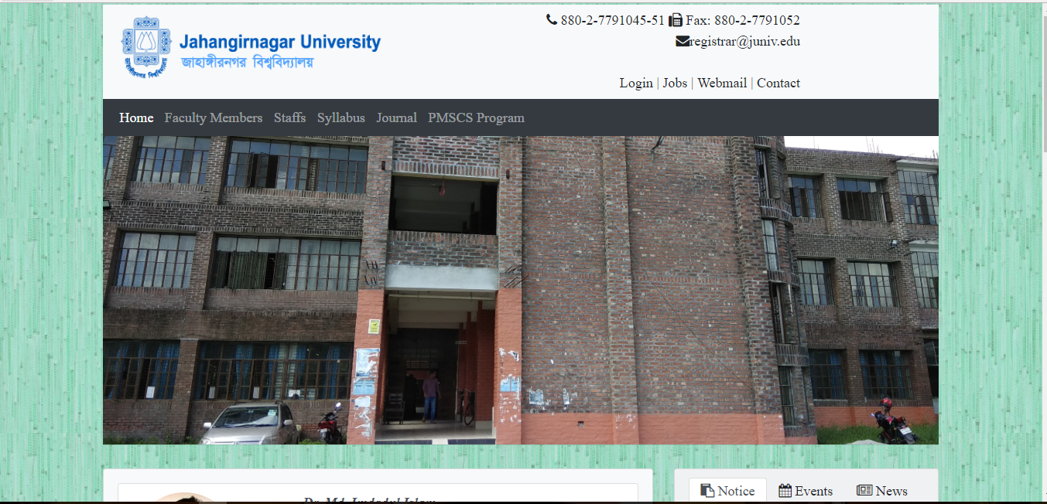
Results
Figure 1: Home page

Slide 13
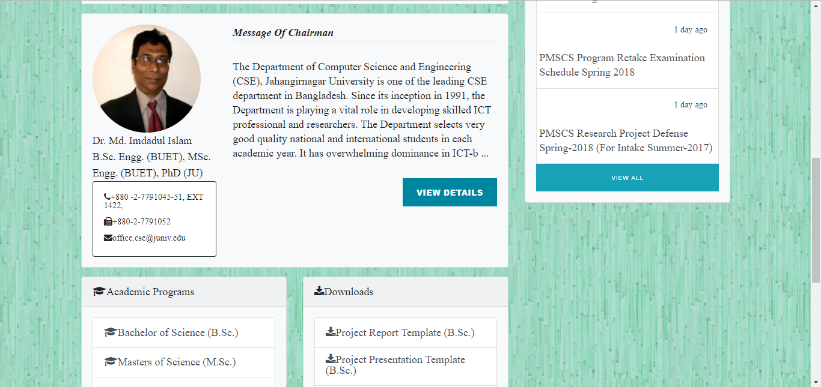
Results
Figure 2: Message of Chairman

Slide 14
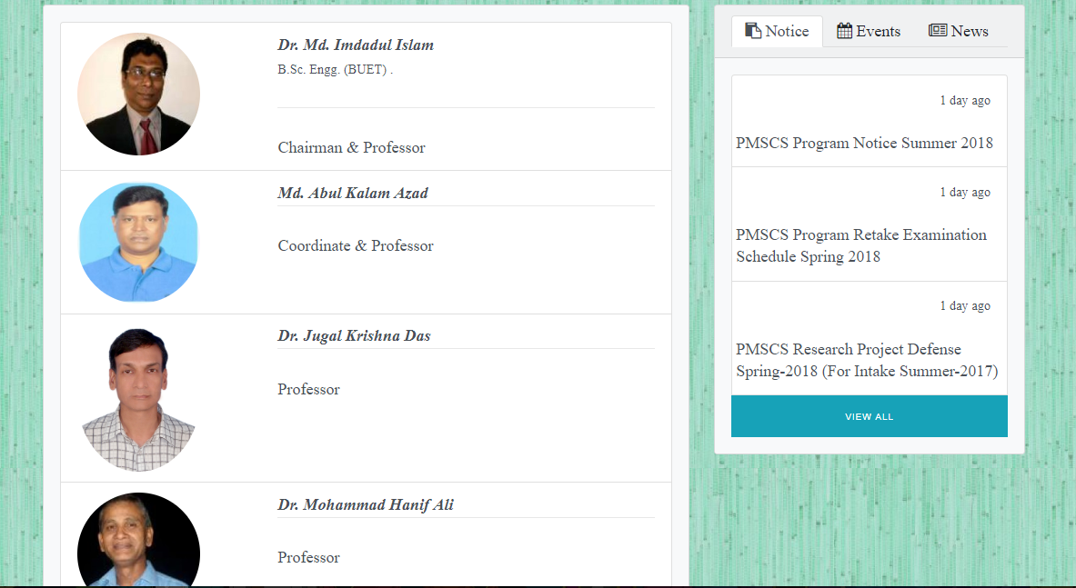
Results
Figure 3: List of faculty members

Slide 15
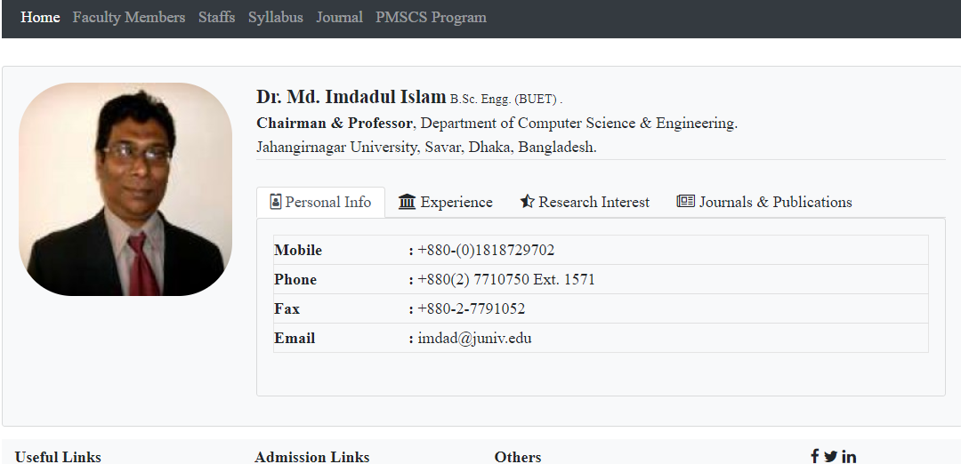
Results
Figure 4: Teacher profile

Slide 16
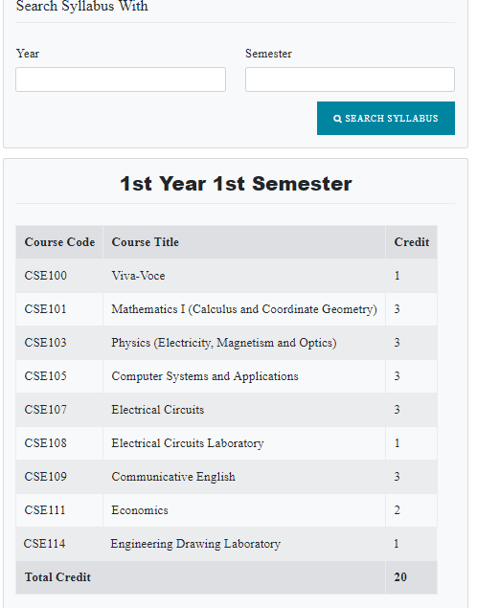
Results
Figure 5: Syllabus of 1st year 1st semester

Slide 17
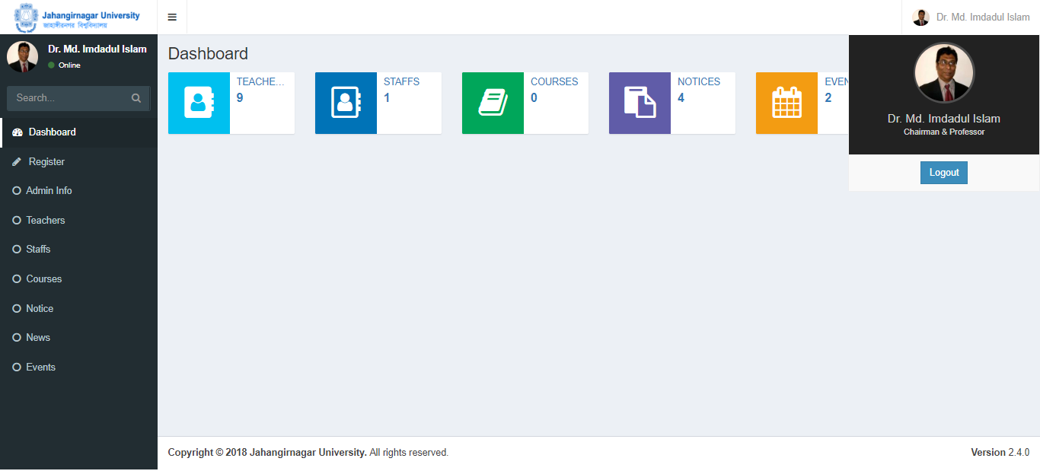
Results
Figure 6: Admin Dashboard

Slide 18
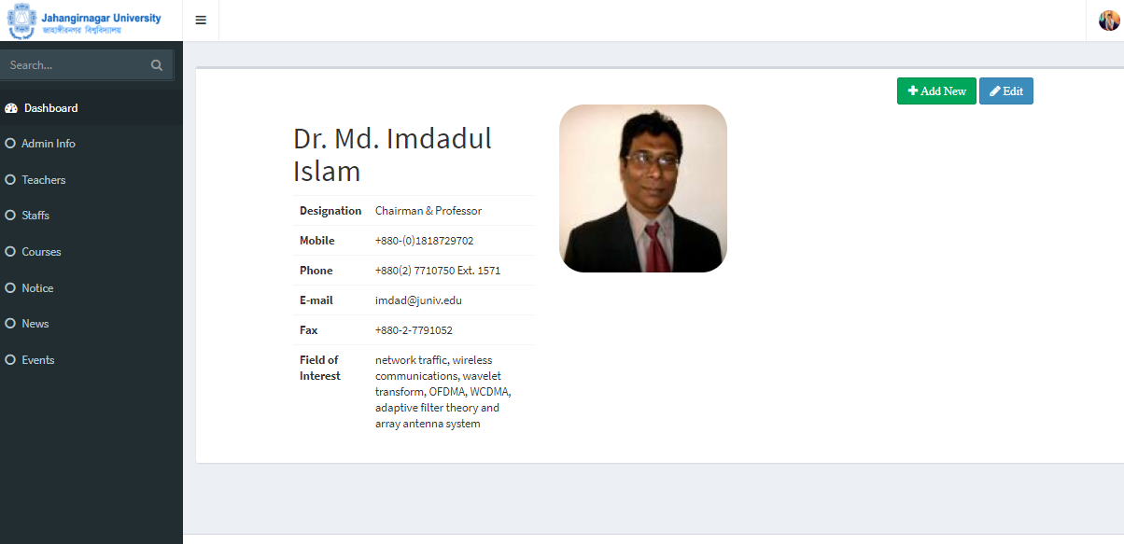
Results
Figure 7: Admin profile

Slide 19
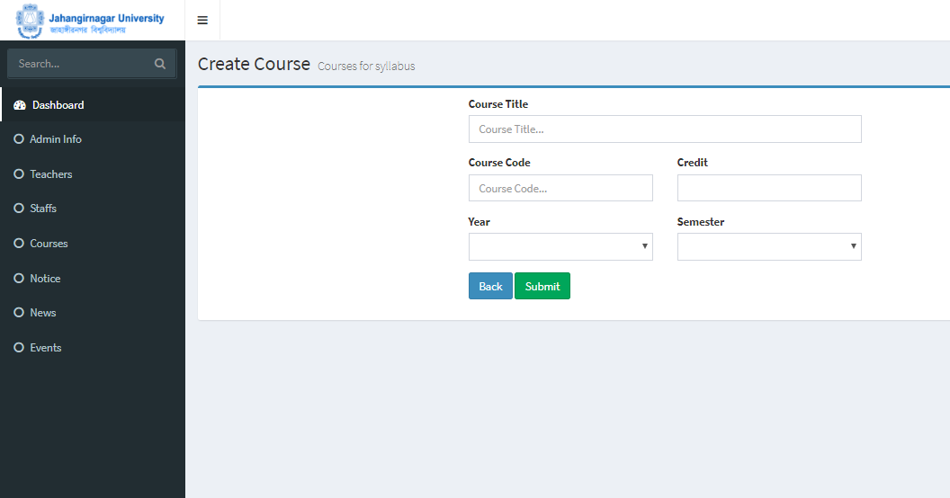
Results
Figure 8: Add course page

Slide 20
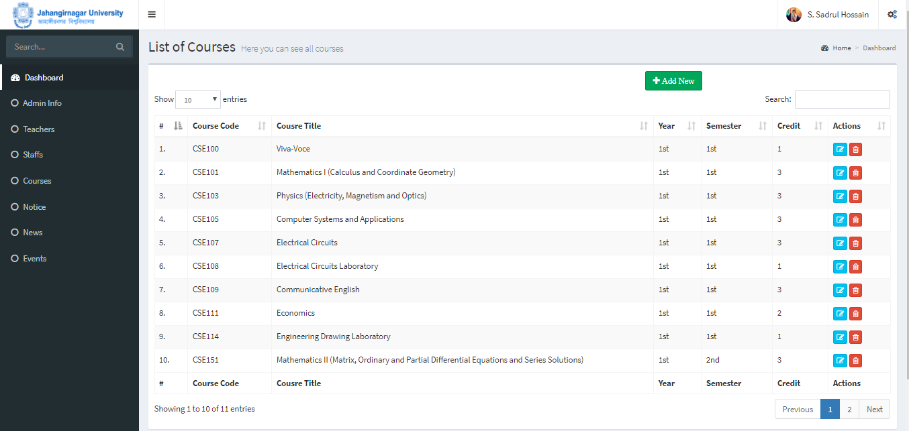
Results
Figure 9: course list page

Slide 21
Conclusion and Future Plan
The developed website fulfill our target with all the given requirements.
Still have lots of scope to improve.
The database has information of only one department. If there is any requirement of expanding the project to university level, then it will be required some modification and more information.
we can hope for future enhancement and establishment of this website project.

Slide 22



